Slide 1
Untargeted Metabolomics
Analysis of E. coli
LC-MS Feature Extraction · Probabilistic Annotation · Statistical Analysis
By Daniel Ghali

Slide 2
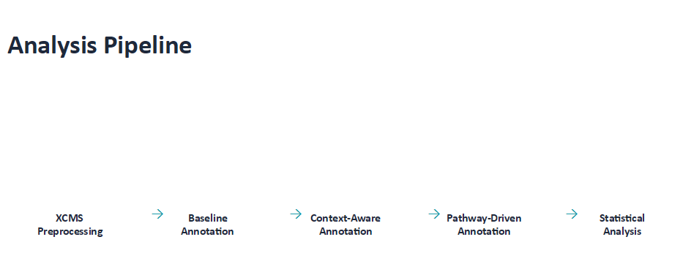

Slide 3
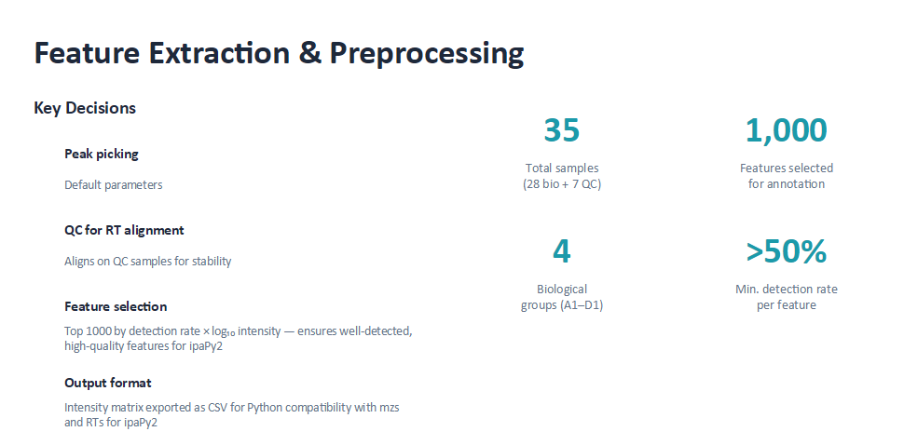
Notes:
1. Corrected for retention time drifting using QC samples, also 0.8 minFraction cutoff was used to ensure peak groups were detected in at least 80% of the QC samples
2. 1 Removes features detected in 50% or fewer samples which reduced the features from 1192 to 1090. 2 Scores features on detection rate * log transformed mean intensity, then take the top 1000 - this prioritises features based on the consistency of their detection and signal strength

Slide 4
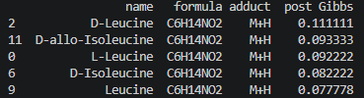
STEP 2 · ANNOTATION
Baseline Annotation with ipaPy2
Annotation Pipeline
Why this feature selection?
Cluster features by isotope patterns
ipaPy2 relies on isotope clusters and adduct relationships. Features selected by detection rate × intensity are more likely to form complete isotope patterns and produce reliable adduct connections, which maximises annotation quality.
1
Compute all adducts against IPA_MS1 database
2
Top 5 by post Gibbs score
MS1 annotation: match features to candidates within 3 ppm
3
Gibbs sampler (adducts only)
4
Notes:
- I did MS1 annotation and used the gibbs sampler to estimate posterior probabilities
- All top candidates have similar post Gibbs probabilities – making the results not very meaningful

Slide 5
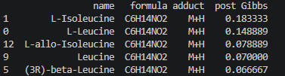
STEP 3 · ECMDB PRIOR
Context-Aware Annotation
Strategy
Assumption: metabolites in ECMDB are likely present in E. coli samples.
Mapping challenge: databases use different identifiers. Dual matching via KEGG ID and InChIKey maximises coverage.
Prior knowledge (pk) assigned:
Top 5 by post Gibbs score
Match type | Prior (pk)
KEGG ID match | 1.0 (highest)
InChIKey match | 0.95
No match | 0.5 (default)
Notes:
- My matching prioritised KEGG and used InChIKey if KEGG was not found
- L amino acids have the highest gibbs score now – they are the most common amino acid metabolites for E. coli so this makes sense

Slide 6
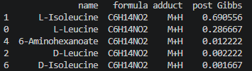
STEP 4 · PATHWAYS
Pathway-Driven Annotation via Biochemical Connections
KEGG
REST API
Compound
Extraction
Build BIO data frame
Gibbs
Sampler and Gibbs Sampler Bio Add
Gibbs
Sampler
Gibbs
Sampler and Gibbs Sampler Bio Add
Gibbs Sampler Bio Add
→
→
→
→
List all E. coli
pathways
Extract compounds per pathway
Reduce the compound lists to 499 unique compound pairs
delta_bio=0.5, noits=2000
~66 min runtime
delta_bio=0.5, noits=2000
delta_bio=0.5, noits=2000
~66 min runtime
Use pathway information and Adduct connections to improve annotation
65/938
0.73
6.9%
Features with shifted
posterior probability
Max posterior shift
(individual feature)
Features affected
(pathway co-members)
Top 5 by post Gibbs score
Notes:
- Used Kegg rest API to create a BIO dataset specific to E. coli metabolites
- delta_bio was first run at 0.1 which produced a negligible shift in its post Gibbs score, I calculated the sum of absolute changes in probability across all annotations to be 0
- So I increased delta_bio to 0.5 and that score changed to 0.19 – confirming that the biochemical connections had an impact on the annotation
- L-isoleucine increases greatly in post gibbs score and in distinction from other candidates

Slide 7
STEP 4 · EXAMPLE
Examples of improved annotation confidence
Percentages show post Gibbs score
STEP 2 — Baseline
STEP 4 — Bio+Adducts
L-Isoleucine
9.2%
L-Isoleucine
69.1%
→
L-Leucine
6.3%
L-Leucine
28.7%
Other candidates in top 5
8.2 – 11.1%
Other candidates in top 5
0.1 - 0.2%
Biochemical pathway linking and adduct connection consideration boosts L-Isoleucine confidence from 9.2% → 69%
Notes:
- Individually the adduct-level constraints, ECMDB context and biochemical network provide weak discrimination between candidates
- Incorporating them led to a redistribution of probabilities, with increased support for biologically consistent metabolites such as L-isoleucine and L-leucine. This was accompanied by a reduction in probability assigned to alternative candidate metabolites, indicating improved concentration of the probability distribution.

Slide 8
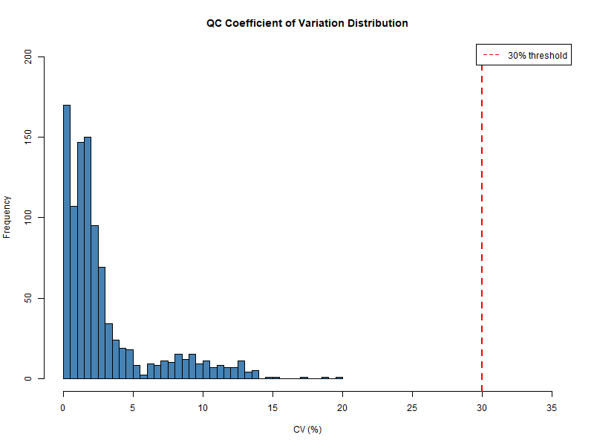
STEP 5 · QC
QC Assessment — Analytical Stability
Conclusion: Instrument was highly stable throughout the run. Data quality is excellent — 99.7% feature retention after QC filtering.
7
QC injections
(pooled samples)
997/1000
Features passing
CV < 30% threshold
1.7%
Median CV
across QC samples
Notes:
- Before biological analyses I validated the data quality using the coefficient of variation
- The median of this across qc samples was 1.7 which represents high quality data and that the instrument used was stable
- This result validates the reliability of everything downstream

Slide 9
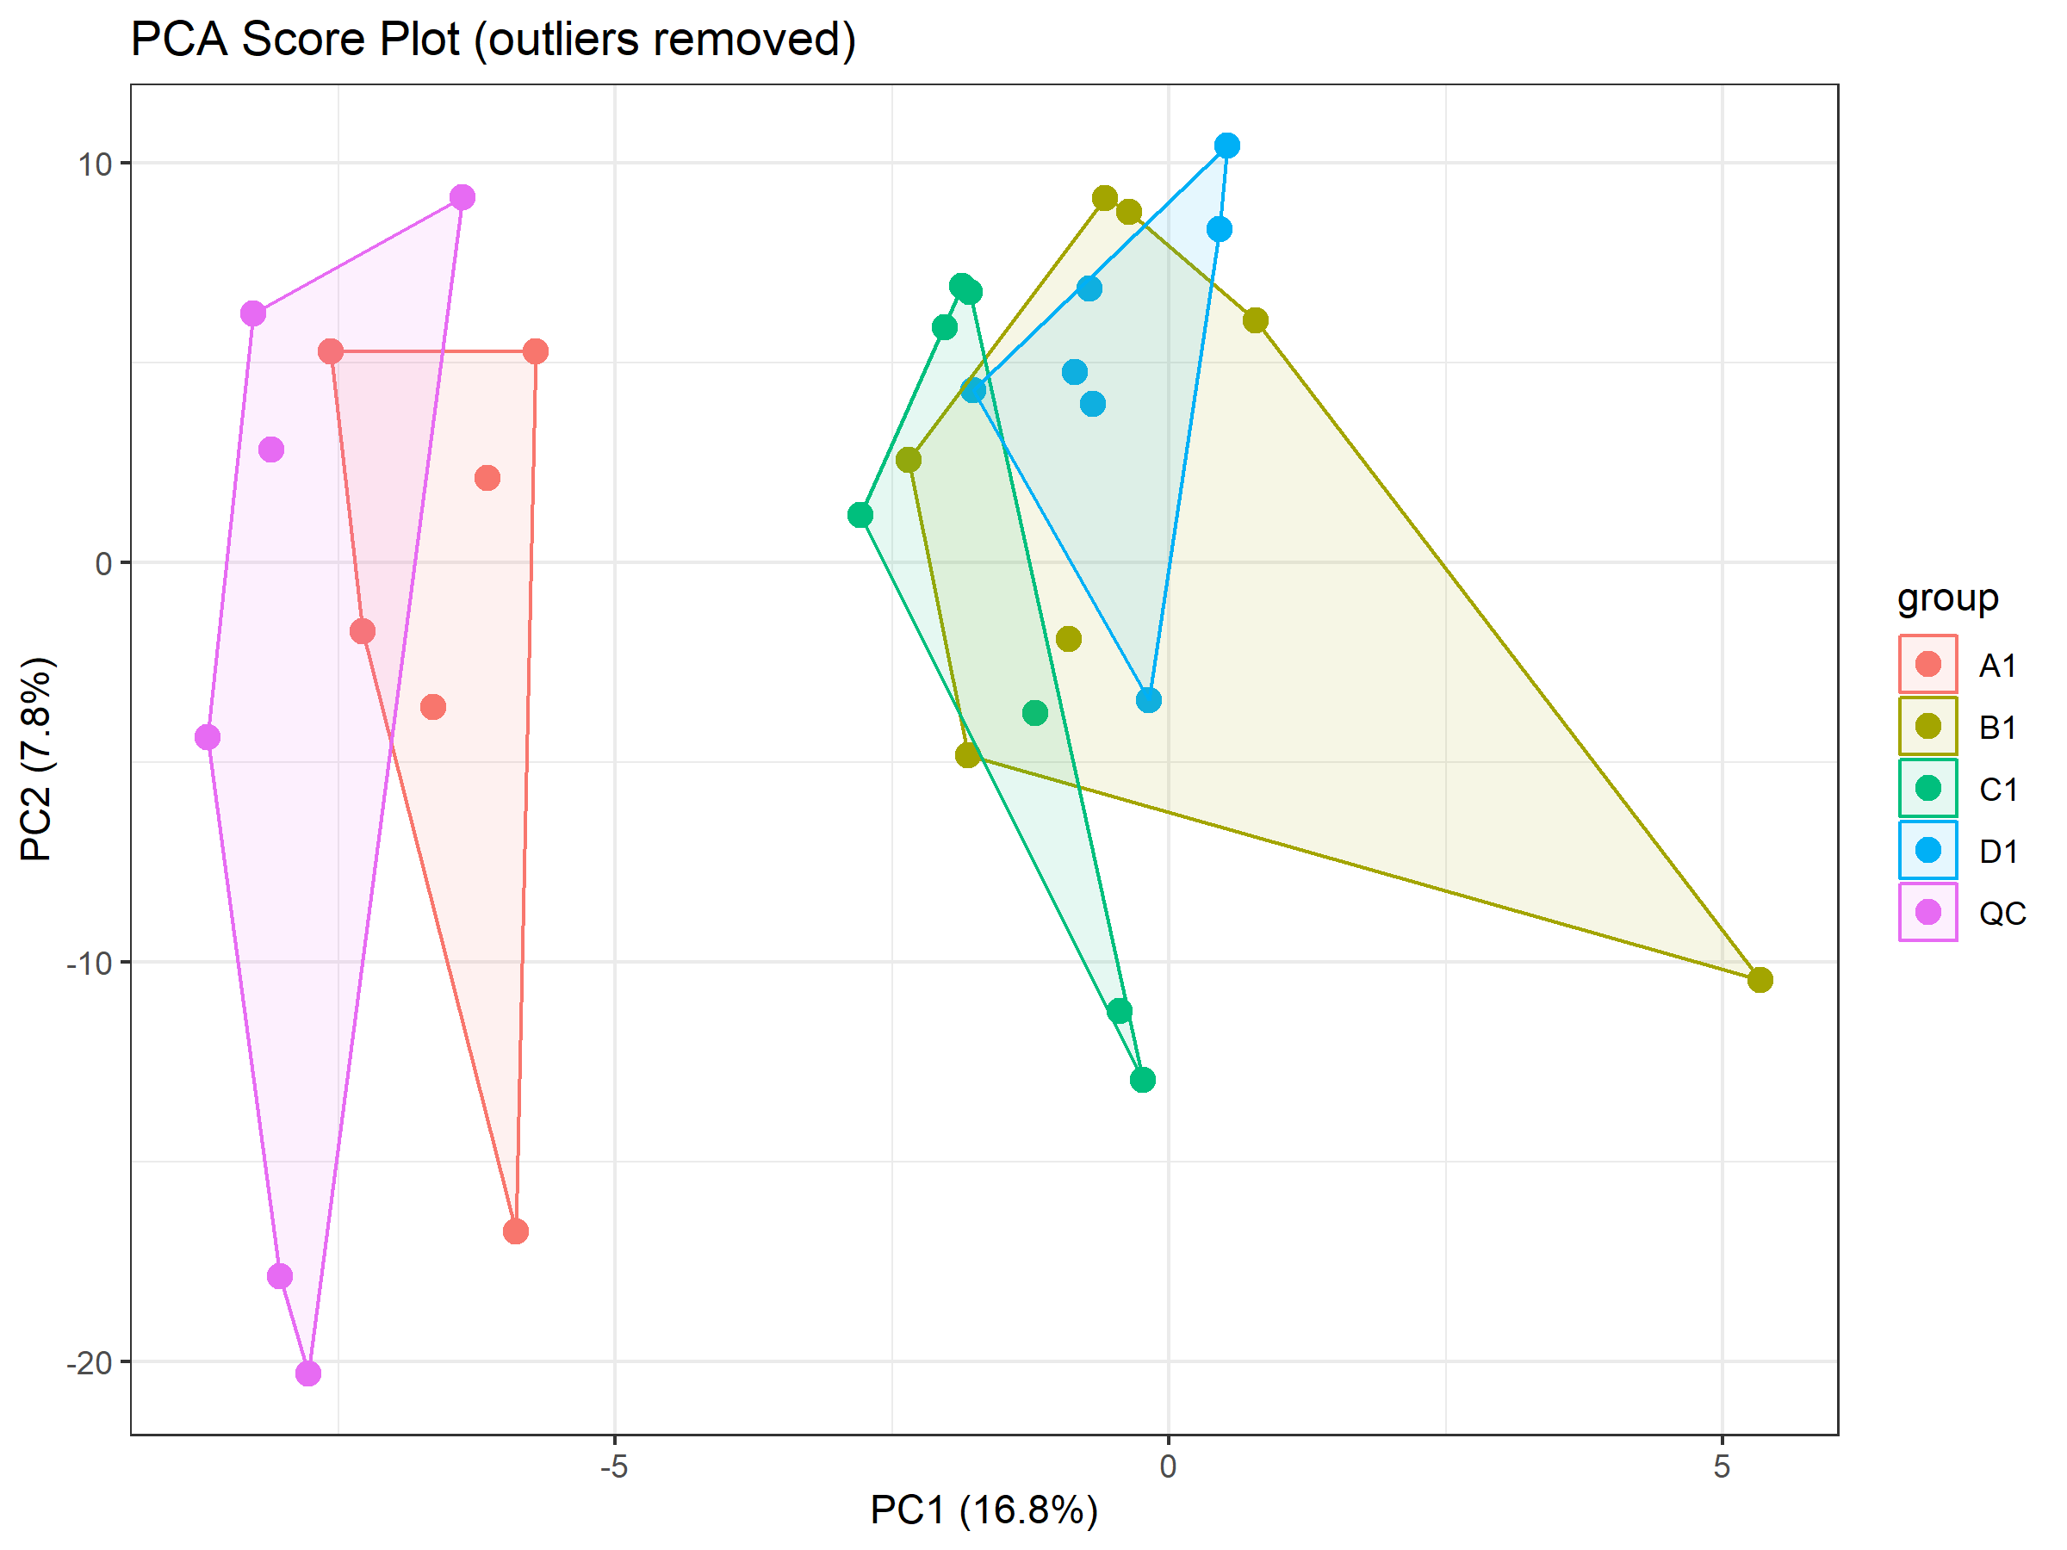
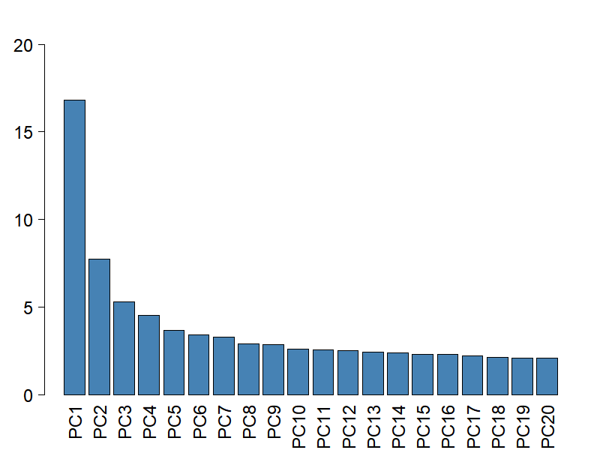
STEP 5 · PCA
Unsupervised Multivariate Analysis — PCA
Key Findings
Separates A1 from B1, C1, D1 — strongest biological signal
PC1 (16.8%)
Within-group biological variability expected for independent cultures
PC2 (7.8%)
Cluster together on PC1 — similar metabolic profiles
B1, C1, D1
6 of 7 QC samples tight with one outlier flagged (likely an injection anomaly)
QC cluster
Variance spread across many PCs — typical for high-dimensional untargeted data
Scree plot
Scree Plot
Variance Explained (%)
Principal Component
Notes:
-When I first ran PCA, two outliers, one from qc diminished the true picture so I removed them
- PC1 then revealed that group A1 separates clearly from B1, C1 and D1 – the strongest signal in the dataset
- The broader spread of variance across PC2 and higher principal components is not a major limitation, as this is typical of high-dimensional metabolomics datasets

Slide 10
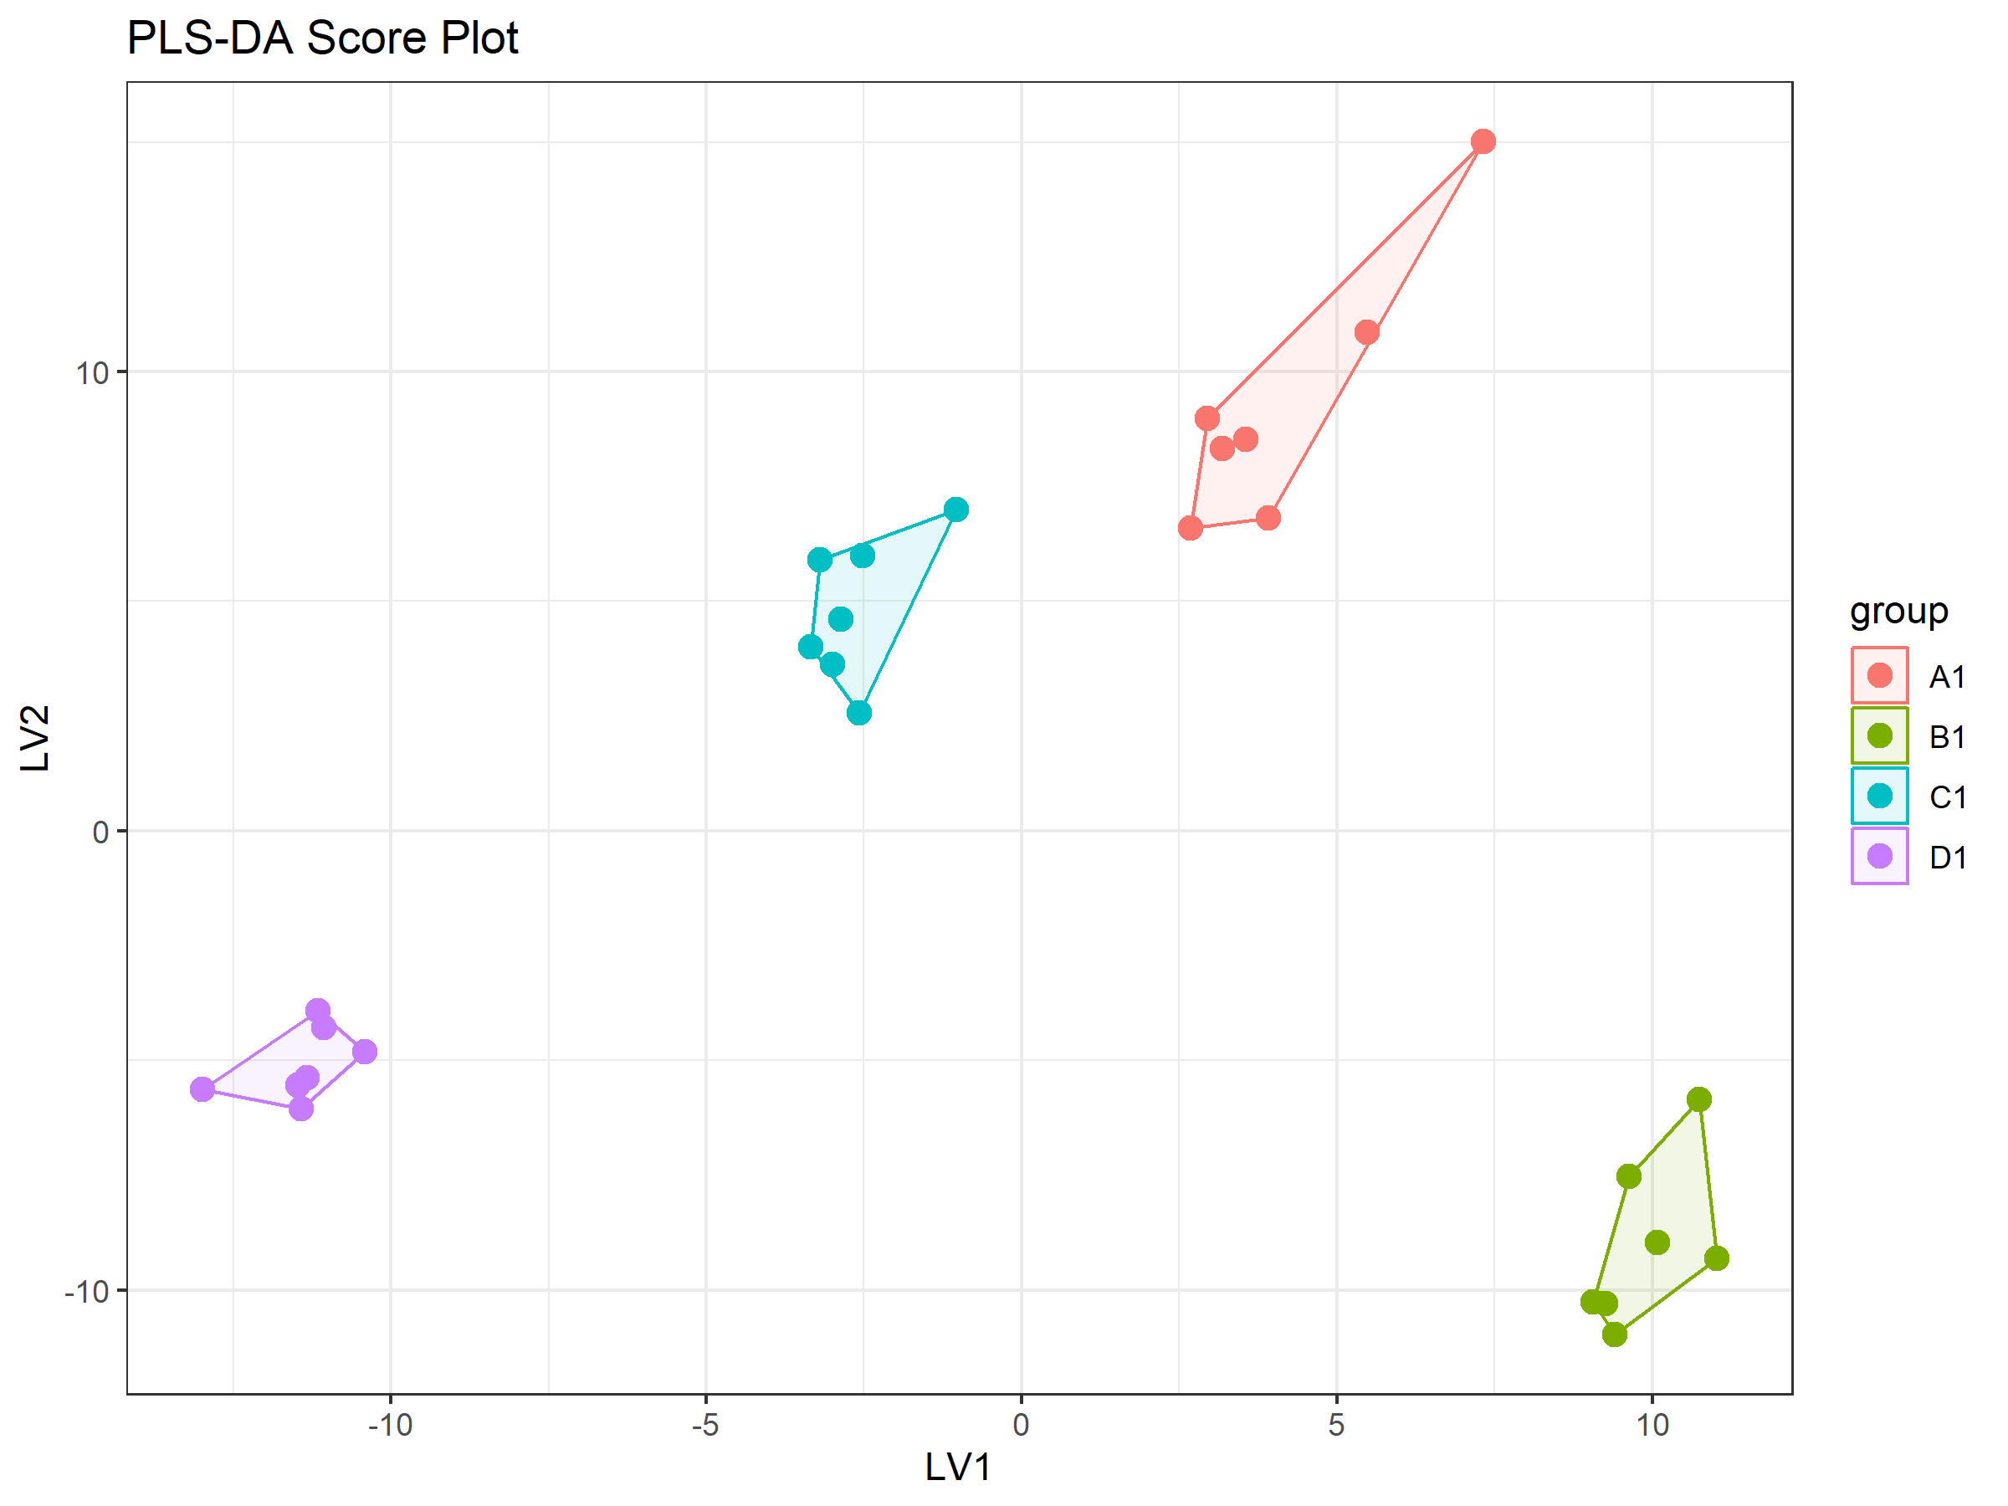
STEP 5 · STATISTICS
Supervised Analysis & Univariate Testing
ANOVA + FDR Correction
87
78
Significant features
(FDR < 0.05)
Significant features
(FDR < 0.01)
Benjamini-Hochberg correction applied across 997 features to control false discovery rate. 78/87 features hold at the more stringent 0.01 threshold — robust signals.
0.135
0.643
0.305
0.05
R²X
R²Y
Q²
p(Q²)
Notes:
- partial least squares discriminate analysis was then used to further investigate group separation
- R2Y of 0.643 shows that the group separation is biologically driven
- The Q2 value of 0.305 is more modest and depicts the group overlap that we observed before
- One way ANOVA demonstrates 87 significant features with 78 at 0.01 false discovery rate

Slide 11
Conclusions
Biological Insight
E. coli metabolic response is dominated by a single strong perturbation (A1), while B1/C1/D1 represent a metabolically related baseline state with subtle separation.
Methodological Insight
The largest gains in annotation confidence arise from combining weak evidence sources (adduct structure, MS1 scores, and biochemical connectivity), rather than relying on any single feature.
Network Constrained
Metabolite identification is not independent across features. The context of biochemical connectivity improves annotation confidence, demonstrating the benefit of network aware models.
Broad Metabolic Response
ANOVA identified 87 features, likely reflecting coordinated metabolic shifts, predominantly driven by the A1 condition, rather than independent biochemical events.
Overlap Limitation
Low Q² (0.305) and PCA overlap reflects genuine metabolic similarity between B1/C1/D1 and small n (7/group), rather than a data quality issue.
Notes:
1. the main biological signal is a metabolic shift in the condition A1, whilst B1, C1 and D1 remain closely related, suggesting a similar baseline metabolic state
2. The pipeline demonstrates that weak sources can be combined to provide robust increases in annotation confidence
3. Metabolite identification can be improved by considering biochemical connection which shows the benefit of a network aware model
4. ANOVA identified that 87 features make up this metabolic response, mainly driven by the A1 condition
5. Finally, we can see that the Low Q2 score and PCA overlap reflect metabolic similarity between b1 c1 and d1, rather than a weakness of the data

